Slide 1
Unit-1 Basics of Digital Electronics Combinational Circuits Multiplexers-Demultiplexers Decoder-Encoder Sequential Circuits Shift Registers

Slide 2
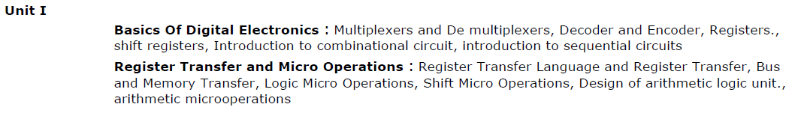
UNIT 1 : Basics of Digital Electronics Register Transfer and Micro Operations

Slide 3
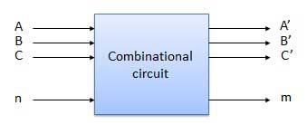
Combinational Circuits
output depends only on the present input
The combinational circuit do not use any memory.
The previous state of input does not have any effect on the present state of the circuit.

Slide 4
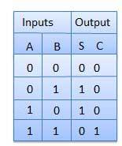

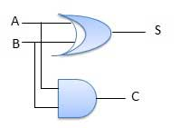
Half Adder
A combinational logic circuit with two inputs and two outputs.
The half adder circuit add two single bit Cary number
This circuit has two outputs carry and sum.
S(A, B) = ∑m (1, 2)
CY(A, B) = ∑m (3)

Slide 6
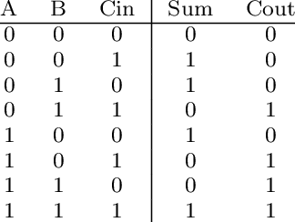
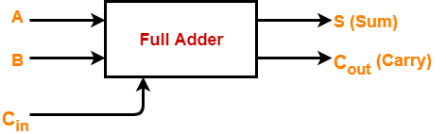
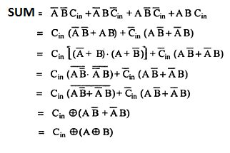
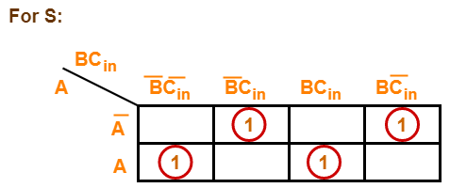
Full Adder (1-bit Adder)
A combinational logic circuit with 3 inputs and 2 outputs.
The Full adder circuit add 3 single bit Cary number
This circuit has two outputs carry and sum.
Sum(A, B,C) = ∑m (1, 2, 4, 7)
Cout(A, B, C) = ∑m (3,5,6,7)

Slide 7
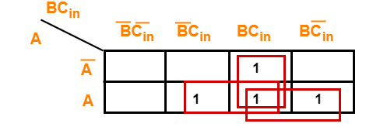
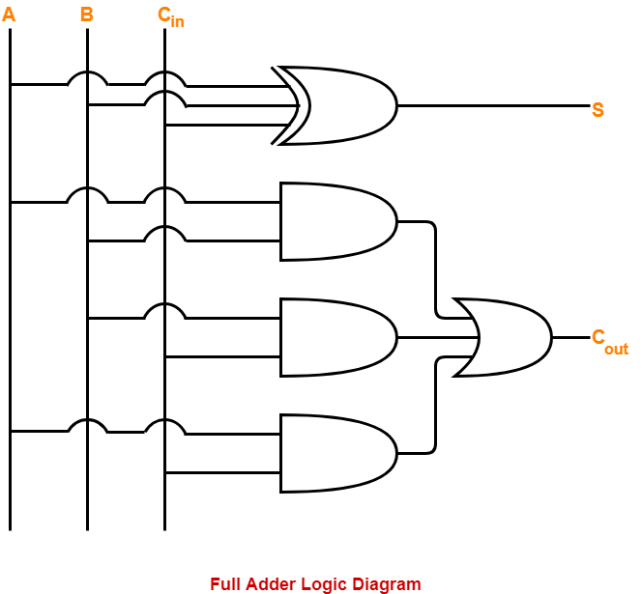
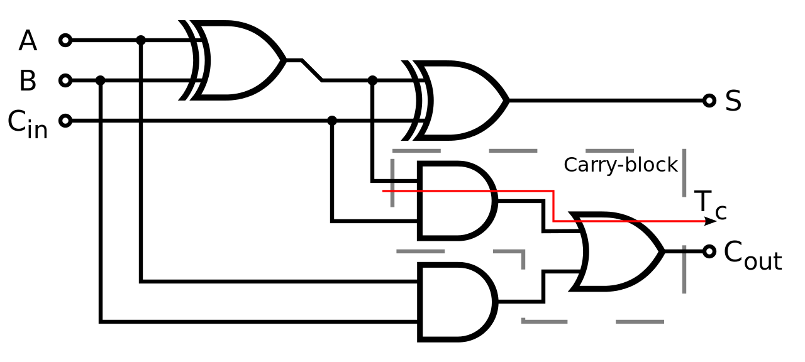
For Cout
Cout=AB+BC+AC

Slide 9
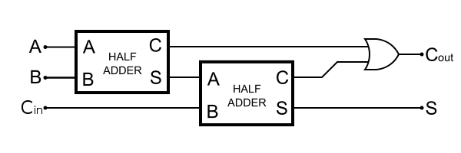
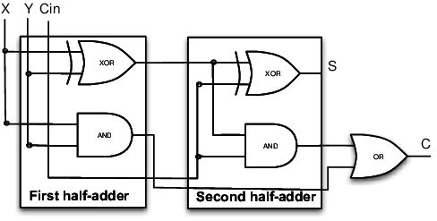
Full Adder using Half Adder
FA
Sum= A⊕B⊕C
Carry=AB+(A⊕B)C
HA
Sum= A⊕B
Carry=AB

Slide 10
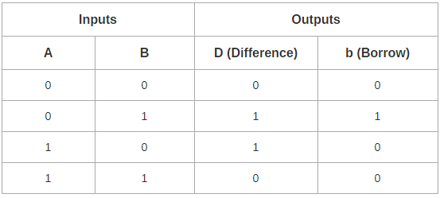
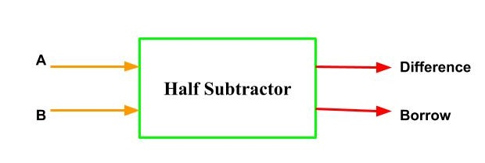
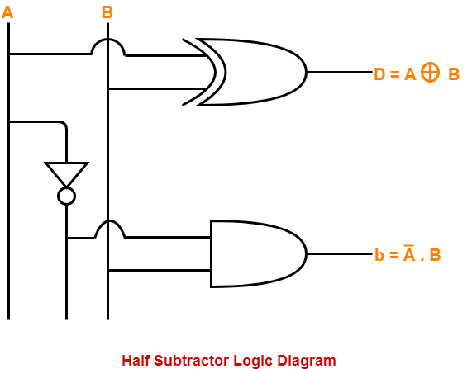
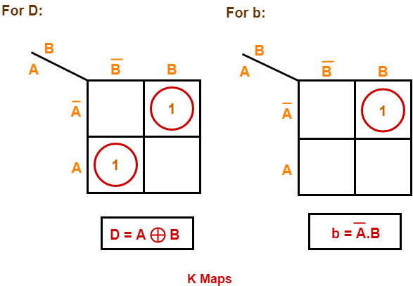
Half Subtractor
Combinational circuit perform binary Subtraction
Accepts 2 input and Two output Difference and Borrow
D(A, B) = ∑m (1, 2)
Br(A, B) = ∑m (1)

Slide 11
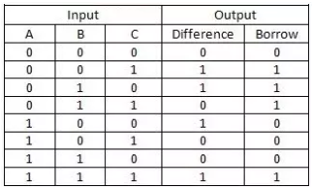
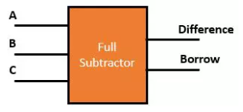
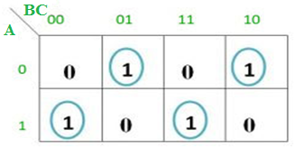
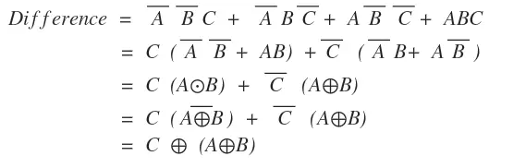
Full Subtractor
Performs subtraction of 3 bits
This circuit has three inputs and two outputs.
The three inputs A, B and C, denote the minuend, subtrahend, and previous borrow, respectively.
The two outputs, D and Bout
Sum(A, B,C) = ∑m (1, 2, 4, 7)
Bout(A, B,C) = ∑m (1,2,3,7)

Slide 12
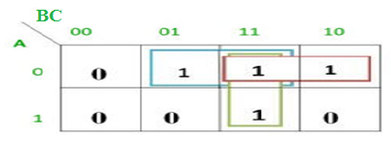

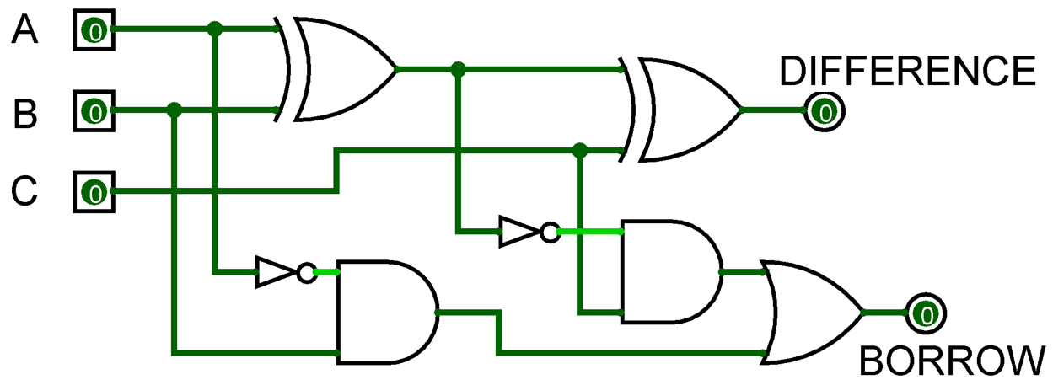
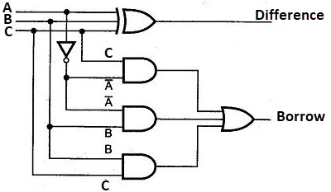
Bout = A’B’C + A’BC’ + A’BC + ABC
= C(AB + A’B’) + A’B(C + C’)
= C( A XNOR B) + A’B
= C (A XOR B)’ + A’B

Slide 14
The simplified expression of full adder carry
A) C= xy+yz+xz
B) C= xy
C) C= yz
D) x+y+z

Slide 15
The difference bit output of a half subtractor is the same as
A) Difference bit output of full subtractor
B) Sum bit output of half adder
C) Sum bit output of full adder
D) Carry bit output of half adder

Slide 16
A logic circuit that provides a HIGH output for both inputs HIGH or both inputs LOW is ____________ a) Ex-NOR gate b) OR gate c) Ex-OR gate d) NAND gate

Slide 17
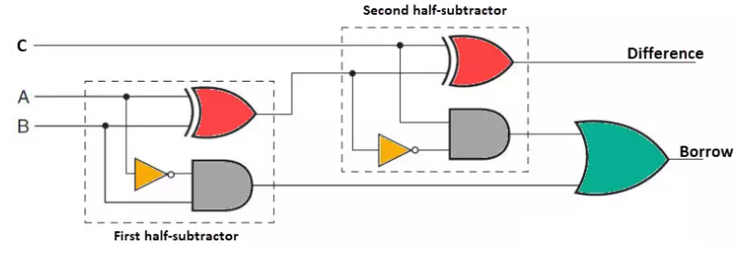
Full Subtractor using Half Subtractor
FS
Sum= A⊕B⊕C
Carry=A’B+(A⊕B)’C
HS
Sum= A⊕B
Carry=A’B

Slide 18
Design a 3 input digital circuit produces high output for two or more binary input high
A | B | C | Y
0 | 0 | 0 | 0
0 | 0 | 1 | 0
0 | 1 | 0 | 0
0 | 1 | 1 | 1
1 | 0 | 0 | 0
1 | 0 | 1 | 1
1 | 1 | 0 | 1
1 | 1 | 1 | 1

Slide 19
Design a 3 input digital circuit produces high output for ODD decimal equivalent
A | B | C | Y
0 | 0 | 0
0 | 0 | 1
0 | 1 | 0
0 | 1 | 1
1 | 0 | 0
1 | 0 | 1
1 | 1 | 0
1 | 1 | 1

Slide 20
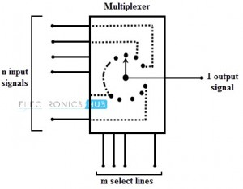
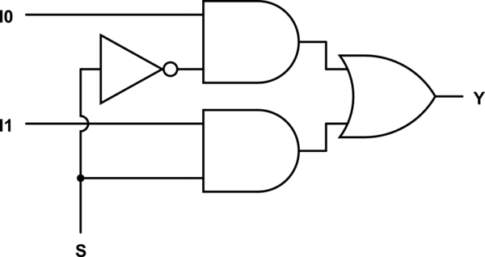
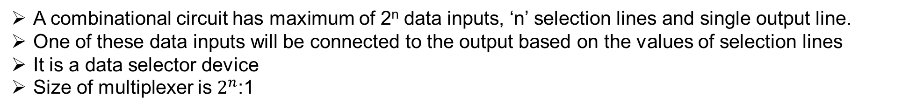
Multiplexer
A combinational circuit has maximum of 2^{n} data inputs, ‘n’ selection lines and single output line.
One of these data inputs will be connected to the output based on the values of selection lines
It is a data selector device
Size of multiplexer is $2^{n}$:1
2:1 Multiplexer
I0
0
Y
=S’I0 + SI1
I1
1
S

Slide 21
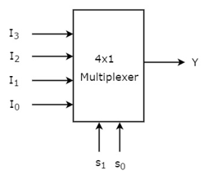

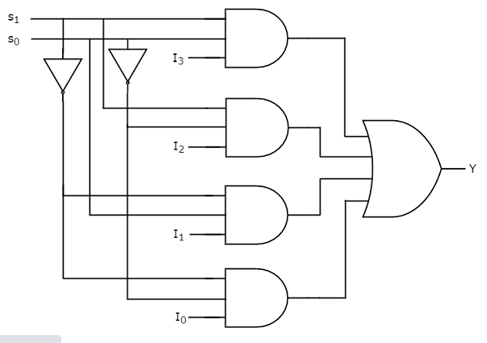
4:1 Multiplexer
Selection Lines |  | Output
S₁ | S₀ | Y
0 | 0 | I₀
0 | 1 | I₁
1 | 0 | I₂
1 | 1 | I₃

Slide 22
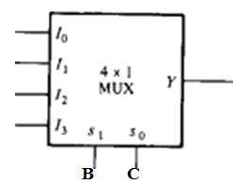
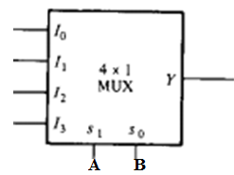
Expression implementation with Multiplexer
Y(A, B,C) = ∑m (1, 3, 5, 6) implement with 4:1 multiplexer
Y(A, B,C) = ∑m (1, 2, 4, 5) implement with 4:1 multiplexer
Any 2 input (AB/BC/AC) select line
Any 2 input (AB/BC/AC) select line
0
C
1
C’
A
1
A’
0
Rearrange equation with selection line
Rearrange equation with selection line
I0 I1 I2 I3
I0 I1 I2 I3

Slide 24
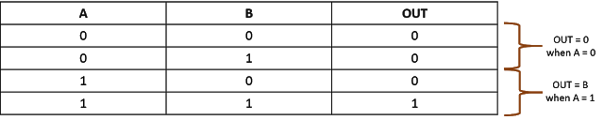

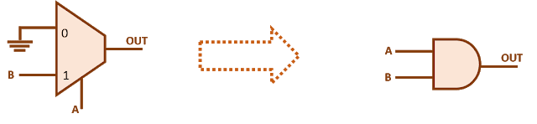
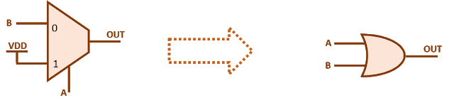


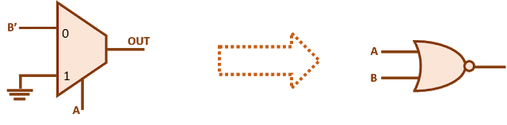
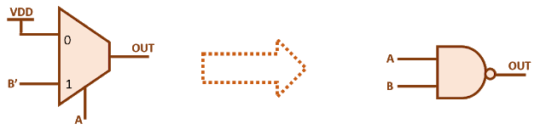
Logic Gate implementation with 2:1 Multiplexer
AND GATE
OR GATE
NOR GATE
NAND GATE

Slide 25


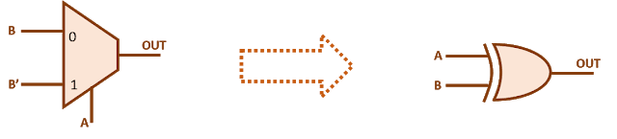
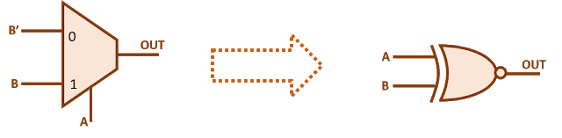
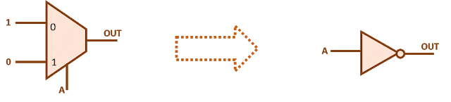

Logic Gate implementation with 2:1 Multiplexer
XOR GATE
XNOR GATE
NOT GATE

Slide 26
In a multiplexer, the selection of a particular input line is controlled by ___________ a) Data controller b) Selected lines c) Logic gates d) Both data controller and selected lines

Slide 27
How many select lines would be required for an 8-line-to-1-line multiplexer? a) 2 b) 4 c) 8 d) 3

Slide 28
For mux, If the number of n selected input lines is equal to 2^m then it requires _____ select lines. a) 2 b) m c) n d) 2^{n}

Slide 30
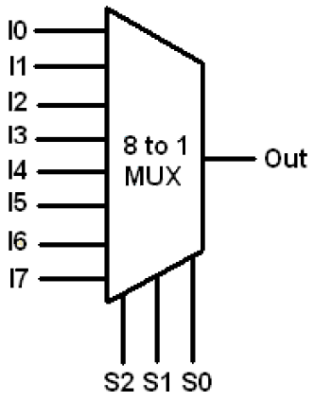
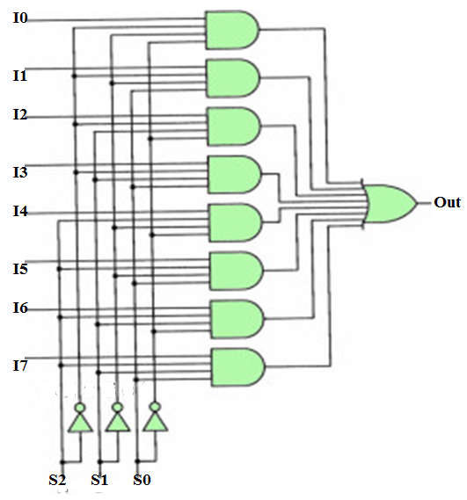
8:1 Multiplexer
S2 | S1 | S0 | Out
0 | 0 | 0 | I0
0 | 0 | 1 | I1
0 | 1 | 0 | I2
0 | 1 | 1 | I3
1 | 0 | 0 | I4
1 | 0 | 1 | I5
1 | 1 | 0 | I6
1 | 1 | 1 | I7
Out=S2’S1’S0’I0 + S2’S1’S0I1+ S2’S1S0’I2+ S2’S1S0I3
S2S1’S0’I4+ S2S1’S0I5+ S2S1S0’I6+ S2S1S0I7

Slide 31
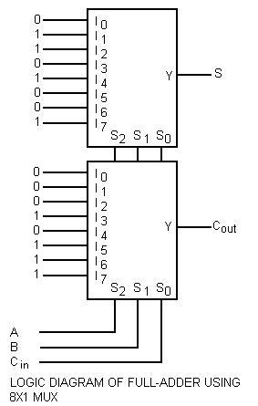
Full adder using 8:1 Mux
S(A, B, C_{in}) = ∑(1, 2, 4, 7)
C_{out}(A, B, C_{in}) = ∑(3, 5, 6, 7)
High input for present minterm, low input for minterm not present

Slide 32
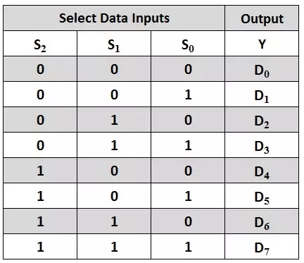
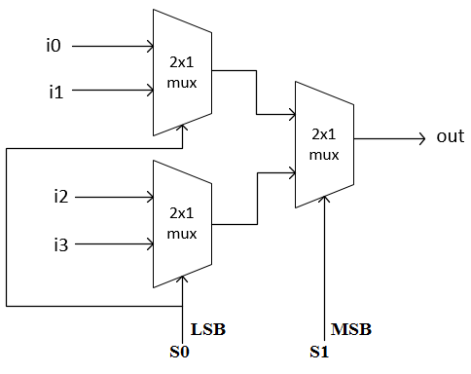
4:1 Mux using 2:1 Mux
8:1 Mux using 4:1 and 2:1 Mux
S1 (MSB) | S0(LSB) | Out
0 | 0 | I0
0 | 1 | I1
1 | 0 | 12
1 | 1 | I3

Slide 33
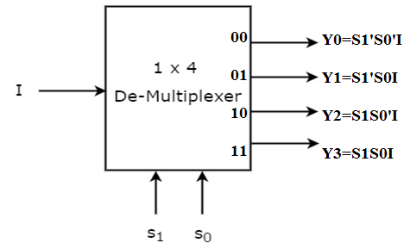
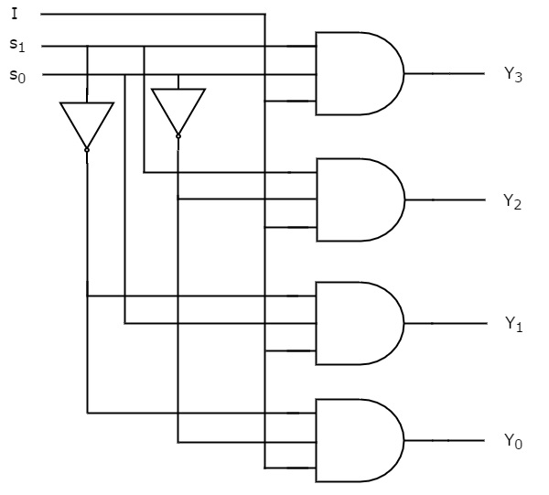
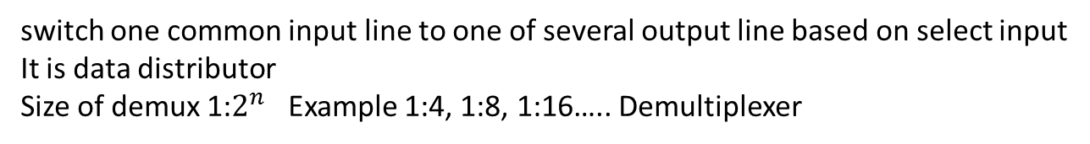
Demultiplexer
switch one common input line to one of several output line based on select input
It is data distributor
Size of demux 1:$2^{n}$ Example 1:4, 1:8, 1:16….. Demultiplexer
Selection Inputs |  | Outputs
S₁ | S₀ | Y₃ | Y₂ | Y₁ | Y₀
0 | 0 | 0 | 0 | 0 | I
0 | 1 | 0 | 0 | I | 0
1 | 0 | 0 | I | 0 | 0
1 | 1 | I | 0 | 0 | 0

Slide 34
Most demultiplexers facilitate which type of conversion?
a) Decimal-to-hexadecimal
b) Single input, multiple outputs
c) AC to DC
d) Odd parity to even parity

Slide 35
Why is a demultiplexer called a data distributor?
a) The input will be distributed to one of the outputs
b) One of the inputs will be selected for the output
c) The output will be distributed to one of the inputs
d) Single input to Single Output

Slide 36
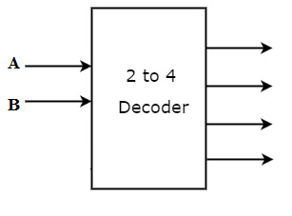

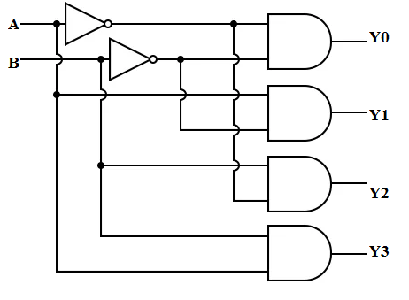
Decoder
A combinational circuit that has ‘n’ input lines and maximum of 2^{n} output lines.
One of these outputs will be active High based on the combination of inputs present, when the decoder is enabled.
The outputs of the decoder are min terms of ‘n’ input variables lines when it is enabled
Size of Decoder are 2:4, 3:8, 4:16….
A₁ | A₀ | Y₃ | Y₂ | Y₁ | Y₀
0 | 0 | 0 | 0 | 0 | 1
0 | 1 | 0 | 0 | 1 | 0
1 | 0 | 0 | 1 | 0 | 0
1 | 1 | 1 | 0 | 0 | 0

Slide 38


Full Adder using 3:8 Decoder
Full Subtractor using 3:8 Decoder
S = A’B’C + A’BC’ + AB’C’ + ABC = Σ(1,2,4,7)
CY = A’BC +AB’C +ABC’+ABC= Σ (3, 5, 6, 7)
DIFFERENCE = A’B’C + A’BC’ + AB’C’ + ABC = Σ(1,2,4,7)
BORROW = A’B’C +A’BC’ +A’BC+ABC= Σ (1, 2, 3, 7)
Y

Slide 39


3:8 decoder using 2:4 decoder
Decoder with Enable
One of outputs will be ‘1’ when enable, E is ‘1’
A2 | A1 | A0 | HIGH OUTPUT
0 | 0 | 0 | Y0
0 | 0 | 1 | Y1
0 | 1 | 0 | Y2
0 | 1 | 1 | Y3
1 | 0 | 0 | Y4
1 | 0 | 1 | Y5
1 | 1 | 0 | Y6
1 | 1 | 1 | Y7

Slide 40
4:16 decoder
A3 | A2 | A1 | A0 | HIGH OUTPUT
0 | 0 | 0 | 0 | Y0
0 | 0 | 0 | 1 | Y1
0 | 0 | 1 | 0 | Y2
0 | 0 | 1 | 1 | Y3
0 | 1 | 0 | 0 | Y4
0 | 1 | 0 | 1 | Y5
0 | 1 | 1 | 0 | Y6
0 | 1 | 1 | 1 | Y7
1 | 0 | 0 | 0 | Y8
1 | 0 | 0 | 1 | Y9
1 | 0 | 1 | 0 | Y10
1 | 0 | 1 | 1 | Y11
1 | 1 | 0 | 0 | Y12
1 | 1 | 0 | 1 | Y13
1 | 1 | 1 | 0 | Y14
1 | 1 | 1 | 1 | Y15
4:16 Decoder
Y0
A3
A2
A1
A0
Y15
EN

Slide 41

4:16 decoder using 3:8 decoder
A3 | A2 | A1 | A0 | HIGH OUTPUT
0 | 0 | 0 | 0 | Y0
0 | 0 | 0 | 1 | Y1
0 | 0 | 1 | 0 | Y2
0 | 0 | 1 | 1 | Y3
0 | 1 | 0 | 0 | Y4
0 | 1 | 0 | 1 | Y5
0 | 1 | 1 | 0 | Y6
0 | 1 | 1 | 1 | Y7
1 | 0 | 0 | 0 | Y8
1 | 0 | 0 | 1 | Y9
1 | 0 | 1 | 0 | Y10
1 | 0 | 1 | 1 | Y11
1 | 1 | 0 | 0 | Y12
1 | 1 | 0 | 1 | Y13
1 | 1 | 1 | 0 | Y14
1 | 1 | 1 | 1 | Y15

Slide 42

4:16 decoder using 2:4 decoder
A3 | A2 | A1 | A0 | HIGH OUTPUT
0 | 0 | 0 | 0 | Y0
0 | 0 | 0 | 1 | Y1
0 | 0 | 1 | 0 | Y2
0 | 0 | 1 | 1 | Y3
0 | 1 | 0 | 0 | Y4
0 | 1 | 0 | 1 | Y5
0 | 1 | 1 | 0 | Y6
0 | 1 | 1 | 1 | Y7
1 | 0 | 0 | 0 | Y8
1 | 0 | 0 | 1 | Y9
1 | 0 | 1 | 0 | Y10
1 | 0 | 1 | 1 | Y11
1 | 1 | 0 | 0 | Y12
1 | 1 | 0 | 1 | Y13
1 | 1 | 1 | 0 | Y14
1 | 1 | 1 | 1 | Y15

Slide 43
A decoder converts n inputs to __________ outputs.
a) n
b) n2
c) 2n
d) nn

Slide 44
A decoder converts n inputs to __________ outputs.
a) n
b) n2
c) 2n
d) nn

Slide 45
Which of the following represents a number of output lines for a decoder with 4 input lines?
a) 15
b) 16
c) 17
d) 18

Slide 46



4:2 Encoder

Slide 47
Combinational Circuits
No feedback paths
No memory
Combinational circuit is a connected arrangement of logic gates with set of inputs and outputs.
Binary values of outputs are a function of binary combination of inputs.

Slide 48
Sequential Circuits
Feedback paths exist
Memory present
2 Types- Synchronous and Asynchronous
Synchronous seq circuits employ signals that effect storage elements only at discrete instants of time.
Synchronization is achieved with help of device called clock.

Slide 49


Slide 50


Slide 51




Slide 52


Slide 53

Integrated Circuits
An IC is a small silicon semiconductors crystal called chip containing the electronic components for digital gates.
Various gates are interconnected inside chip to form required circuit.
Chip is mounted in ceramic/plastic container connected to external pin
Small scale Integration (SSI) : less than 10 gates
Medium Scale Integration(MSI) : between 10 to 200 gates (decoders, adders, registers)
Large Scale Integration(LSI) : between 200 and few thousands gates ( Processors, Memory Chips)
Very Large Scale Integration (VLSI) : Thousands of gate within single package ( Large Memory Arrays, Complex Microcomputer Chips)

Slide 54



